Slide 1


EU/US CDR Policy Comparison
By Alexis Dunand
11 June 2024, Swiss CDR Platform
tracker.carbongap.org

Slide 2

About us
Carbon Gap is Europe’s leading independent, philanthropically- funded, NGO on CDR.
We are advocating to make Europe a leader in just, high quality CDR in line with climate science. We act as a central facilitator in the CDR ecosystem – connecting science with policy making and industry.

Slide 3





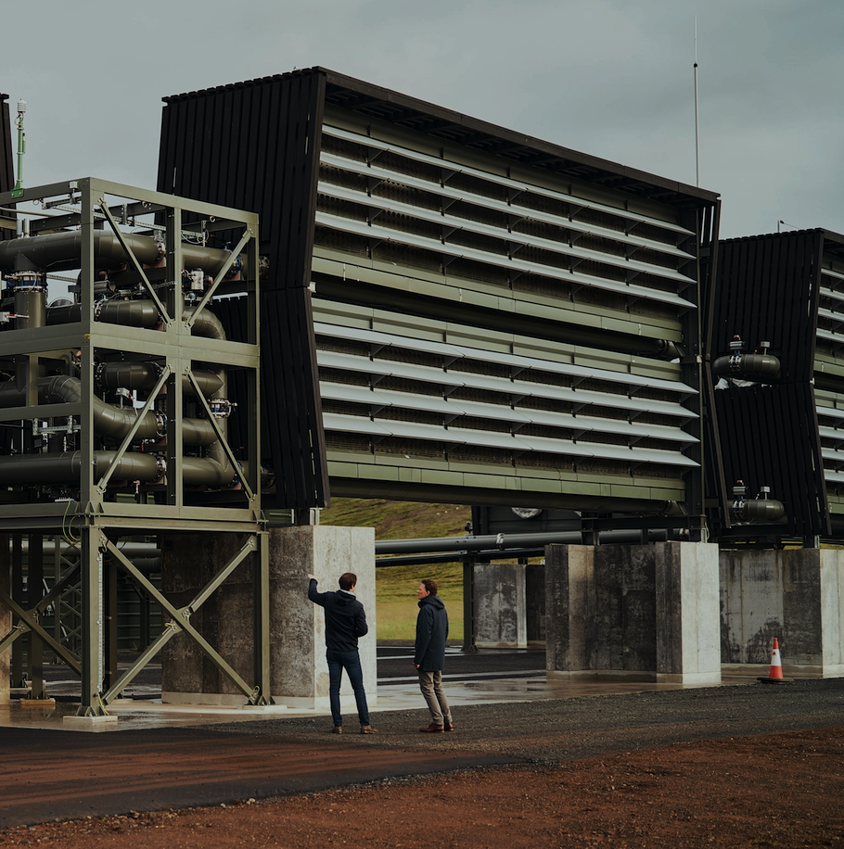
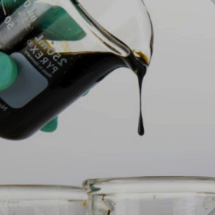




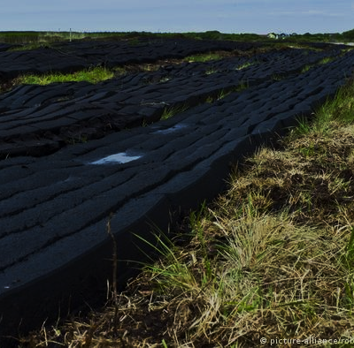
What is
Carbon Dioxide Removal?
CO₂
mineralisation
Biomass CO₂
Removal &
Storage
Ocean alkalinity enhancement
“
Blue carbon
restoration
Direct air
capture
Forestation
Activities that remove CO₂ from the atmosphere and durably store it in geological, terrestrial, or ocean reservoirs, or in products.
”
Bioliquid
injection
Biochar
Soil carbon
sequestration
- IPCC, Working Group III
A vast array of Carbon Dioxide Removal solutions can be scaled up for impact.
Mineral soil
amendment
Frontier
CDR
Peat
restoration

Slide 4
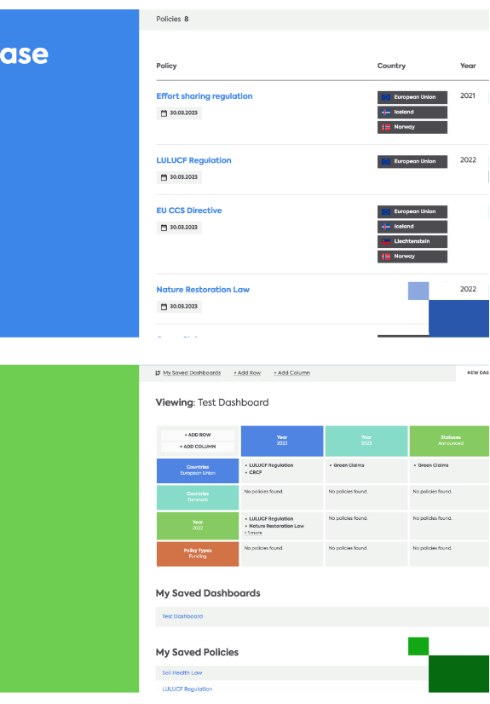

The
Policy Tracker
Database
Map
Dashboard
Resources

Slide 5















Tracker funding partner
Tracker collaborators

Slide 6
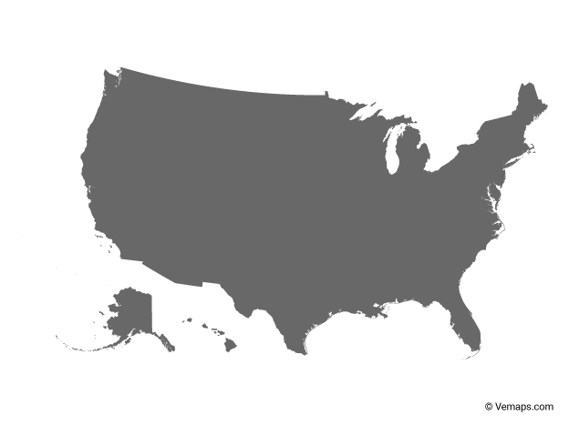

Introducing the
EU-US Comparison

Slide 7
Fostering transatlantic exchange on CDR
Over the last year, we took a deep dive into US and European CDR policies, looking at six topics:
Government procurement
Certification/MRV
Transport & storage infrastructure
Compliance regimes
Research & innovation funding
Deployment Incentives
We identified gaps and best practices in the EU and the US, trying to draw lessons and conclusions to inform our policy advocacy.
In collaboration with Katie Lebling and Danielle Riedl from the World Resource Institute.
EU-US Comparison

Slide 8
Government procurement .in Europe
Government procurement .in the US
Highlight:
Switzerland through Climate Cent Foundation -> EUR 58 million
Nothing at EU level (yet)
Highlight:
CDR Purchase Pilot Prize -> EUR 35 million, phase 1 complete
Next steps:
Phase 2 started, negotiation of offtake contracts with DoE

Slide 9
Certification & MRV .in Europe
Certification & MRV .in the US
Highlight:
EU CRCF - EU-wide voluntary certification scheme
Next steps:
Adoption and entry into force (end of year) and first methodologies by 2026
Highlight:
Some MRV requirements in 45Q, CDR Purchase Pilot Prize and CCS Protocol in California
Next steps:
DoE funding research to develop umbrella MRV framework

Slide 10
CO₂ transport & storage infrastructure .in Europe
CO₂ transport & storage infrastructure .in the US
Highlight:
Net Zero Industry Act (Art. 18) and TEN-E Regulation
Next steps:
5MtCO₂ injection capacity target by 2030, regulatory framework on CO₂ transport (ICMS)
Highlight:
Bipartisan Infrastructure Law-> substantial funding
Next steps:
Streamlining permitting process at federal and state level

Slide 11
Compliance regimes & CDR in Europe
Compliance regimes & CDR .in the US
Highlight:
UK ahead, consultation on how GGR could be integrated
Next steps:
EU Commission to submit report by July 2026
Highlight:
California Low-Carbon Fuel Standard includes DAC
Next steps:
California CDR Market Development Act (SB308) to be introduced again

Slide 12
RD&I funding for CDR .in Europe
RD&I funding for CDR .in the US
Highlight:
UK: CO2RE Hub (GBP 100 million)
Germany: CDR Terra&Mare
Next steps:
Several call for projects relevant to CDR at EU level
Highlight:
DAC Hubs demonstration funding + DOE funding for pilot demonstration projects
Next steps:
Remaining amount from DAC hubs+ CHIPS and Science Act to be appropriated

Slide 13
Deployment incentives for CDR in Europe
Deployment incentives for CDR .in the US
Coming
Soon

Slide 14


Policy Tracker 2.0
What is coming up next?
1
Mapping funding opportunities
2
Assessing CDR policy progress in countries
3
Revamped website

Slide 15



THANK
YOU
For more, follow us on:
@CarbonGap
@CarbonGap
www.carbongap.org
Carbon Gap is an independent, philanthropically funded, non-profit organisation focused on responsibly scaling up carbon dioxide removal in Europe as an important complement to emissions reductions. We work across all carbon removal methods, bringing the best technical expertise to inform European policymaking. Our advocacy efforts are focused in Brussels, with additional staff presence in France, Switzerland and the UK.
Carbon Gap LTD is a registered charity (charity number 1200562) and a private company limited by guarantee (company number 13557860), registered in England and Wales.
Registered office address: 71-75 Shelton Street, Covent Garden, London, WC2H 9JQ, United Kingdom.
Carbon Gap LTD’s number in the EU Transparency Register is: 159208346089-06

